Slide 1
Best Super Neighborhoods in Houston to open a Restaurant (Part of IBM Applied Data Science Capstone Course) - Wahab Nadir Kadiwar

Slide 2
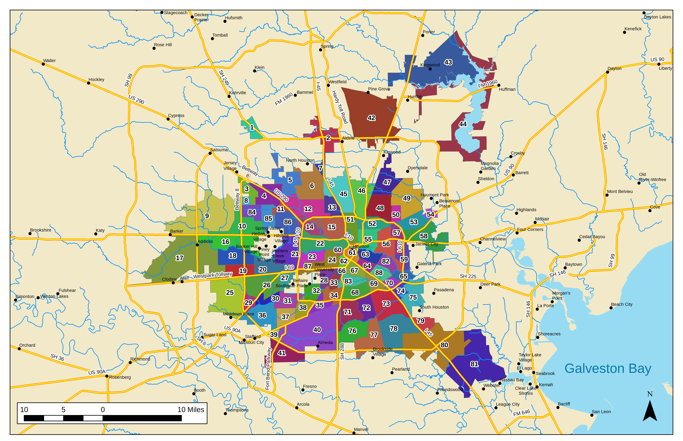
Background Information
Houston
Fourth most populous city in US
Located in southeast Texas near Galveston Bay and Gulf of Mexico
Super Neighborhood
Super neighborhood is a geographically designated area where residents, civic organizations, institutions and businesses work together to identify, plan, and set priorities to address the needs and concerns of their community
Total 88 Super Neighborhoods
Super Neighborhoods of Houston, Texas

Slide 3
Problem statement
To identify the best Super neighborhoods for opening different kinds of restaurants
Features used :
Population density
No. of Housing
Total Restaurants
Demographics

Slide 4

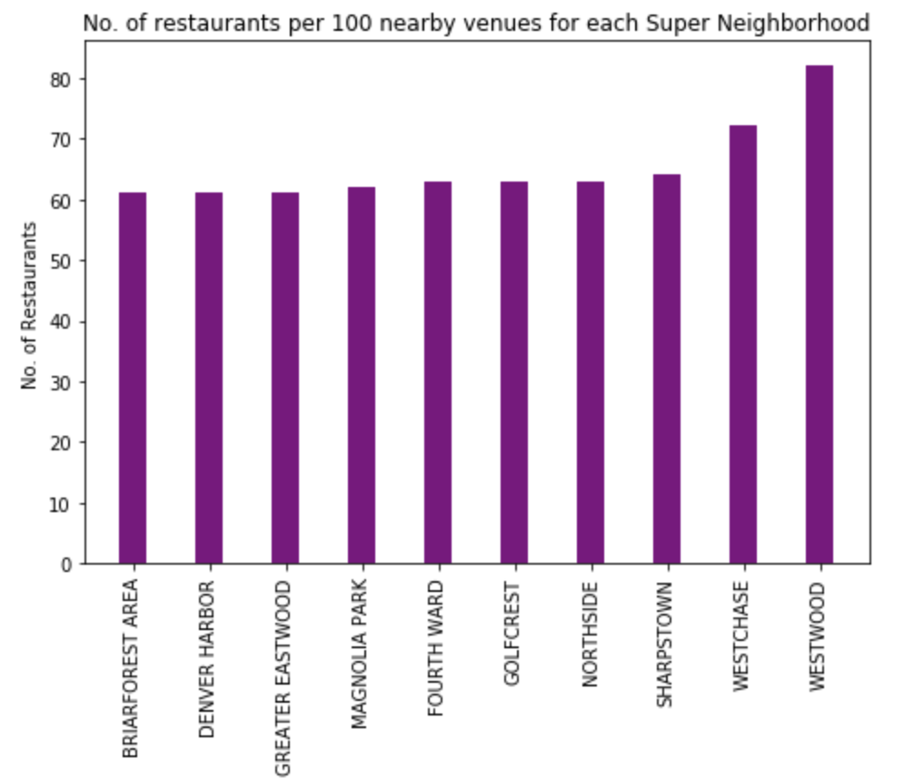
Total Restaurants
- Higher the number of restaurants and bars suggests that the super neighborhood is livelier and happening

Slide 5
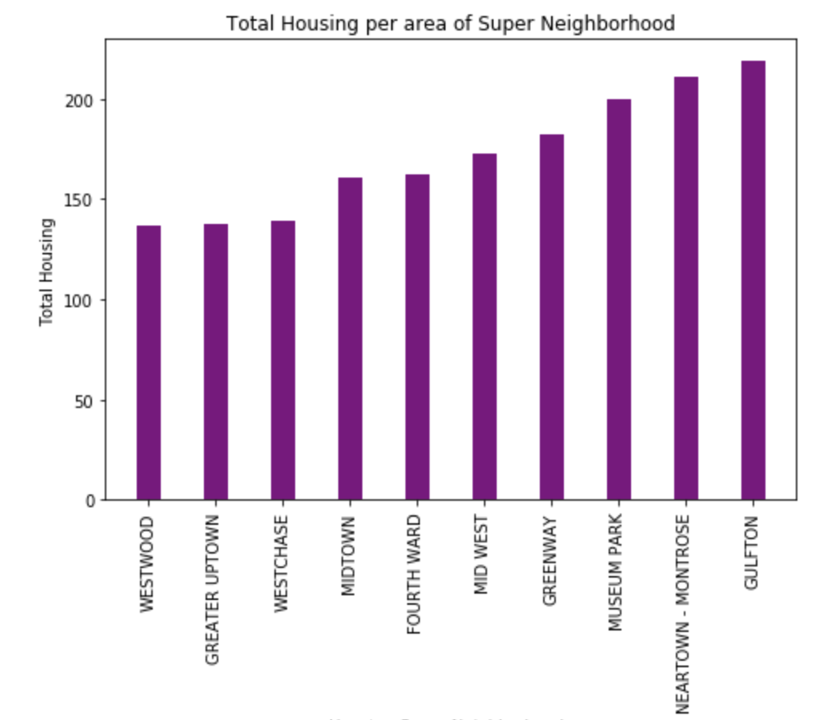
Total Housing
- Greater no. of housing not only increases the number of customers but also increases the amount of home delivery orders

Slide 6
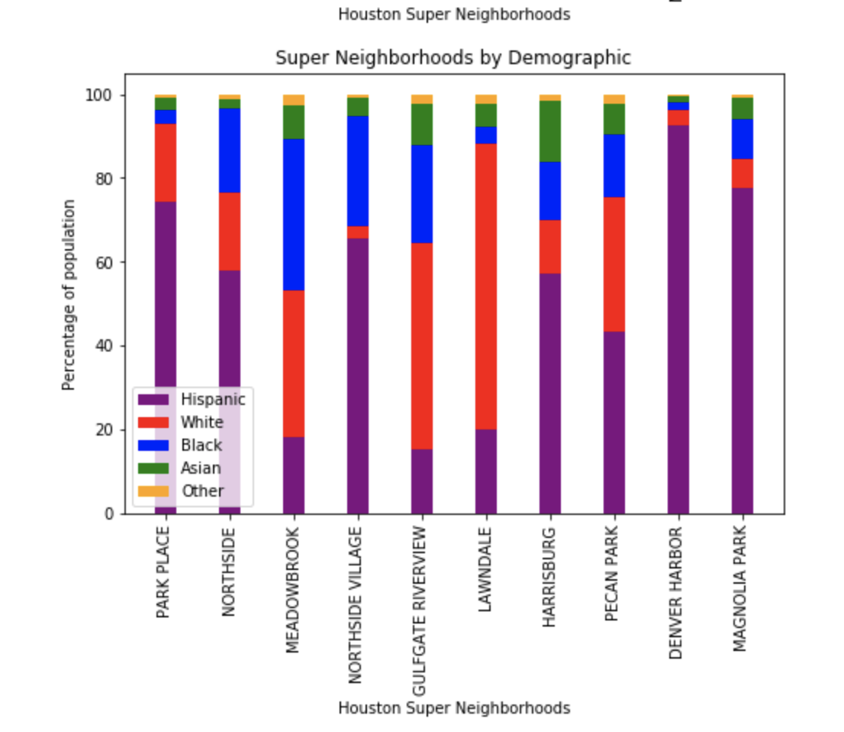
Demographics
- The data about people living in the area is an important factor in deciding the menu and cuisine of the restaurant

Slide 7
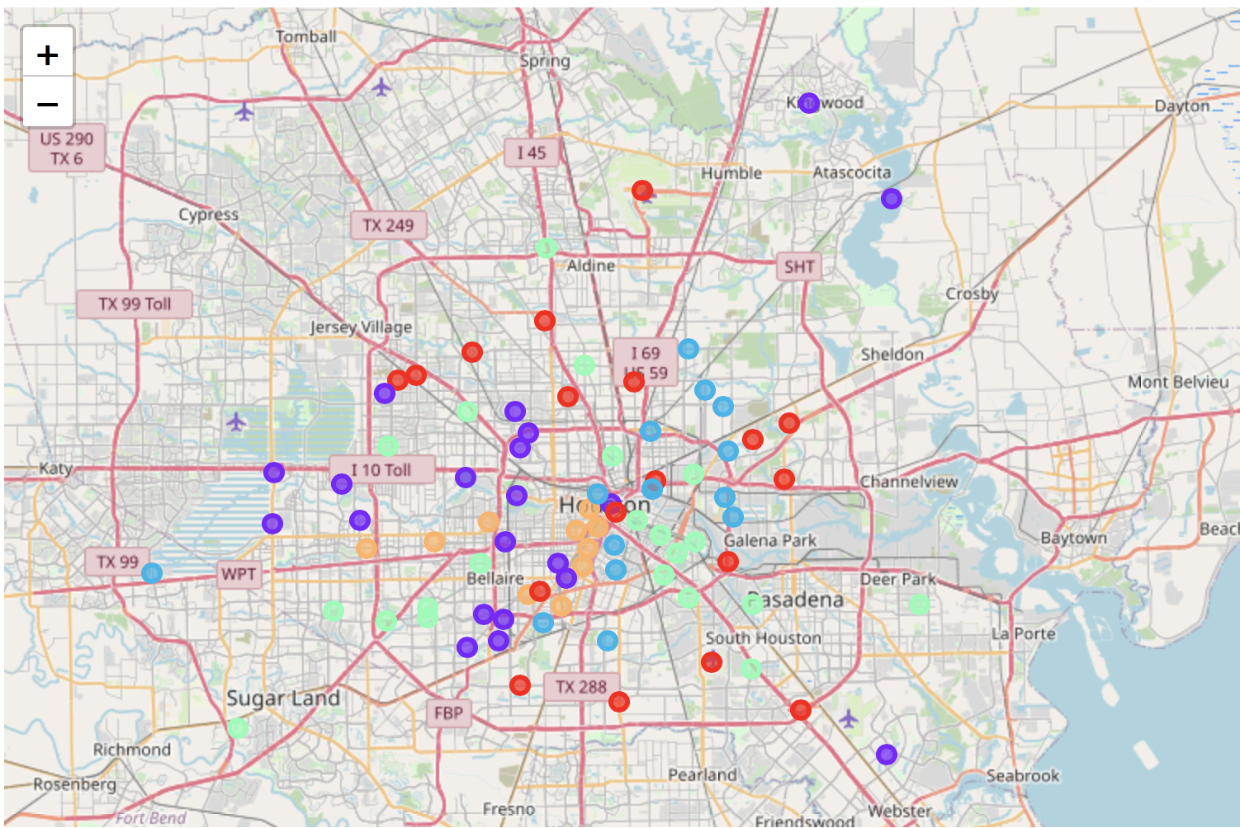
Clustering

Slide 8
Analysis
Cluster number | Cluster Color | Cluster Characteristics | Examples of Super Neighborhoods | Idle for the type of Restaurant
1 | Orange | Happening areas, Best Residential areas | Montrose, Greater Uptown | Fancy and lavish Restaurant
2 | Blue | Developing areas | Mac Gregor, South Main | Fast food restaurant
3 | Violet | Areas with high population density but low housing ratio | Westwood, Sharpstown | Can be decided after considering Crime rate
4 | Green | Office and work areas | Downtown, Medical Center | Deli / Lunch /Breakfast Places
5 | Red | Outskirts and less populated areas of the city | South Belt, IAH | Population and demographics need to considered

Slide 9
Future work
Research can be extended to audience looking for a ideal neighborhood to live by including the below data :
Crime Rate in each area
Housing Cost
No. of schools in the neighborhood
No. of Leisure places in the neighborhood (Example Trail, parks, etc.)

Slide 10
Thank You

